Slide 1


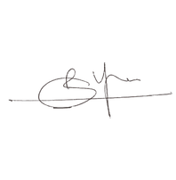
CERTIFICATE
OF WINNER
is proudly presented to
Participant Name
FOR WINNING IN UNO ORGANISED BY
LEVEL UP SOCIETY ON NOVEMBER 18th,2023
CONVENOR

